Slide 1
Audio Harmonizer
Annie Rizvi
Nina Rao
Jason Dimelow
Urinrinoghene Lauretta Omughelli

Slide 2
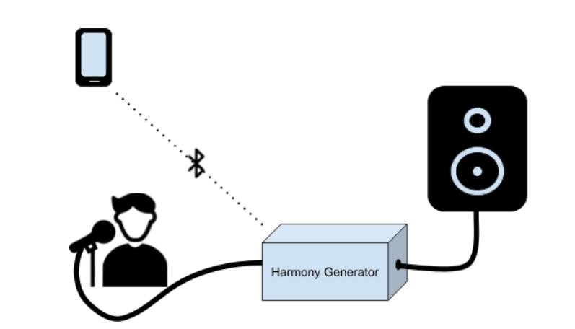
Project Statement
Create a system that allows artists to create multiple harmonies in real time for performances.
Notes:
Jason

Slide 3
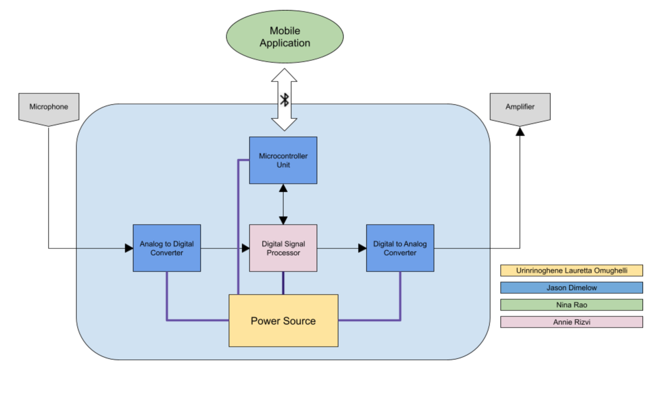
Project Subsystems
Notes:
Nina:

Slide 4
Project Current Timeline
Real-Time Audio Functioning
MCU and Android Application Bluetooth Communication Integrated and Validated
Fuel Gage Integrated (Not Validated)
MCU and DSP I2C Communication Integrated and Validated
Power Supply Integrated (Not Validated)

Slide 5
Digital Signal Processor
Accomplishments Since Last Presentation <35 hrs> | Ongoing progress/problems and plans until next presentation
MSP430 Launchpad and ADC/DAC integration complete Audio working in Real-Time I2C Communication with MCU Integrated and Validated | Use IQMATHLIB for Hamonizing Algorithm and FFTs in MSP430

Slide 6
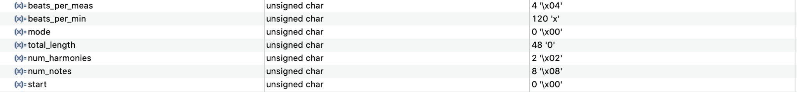
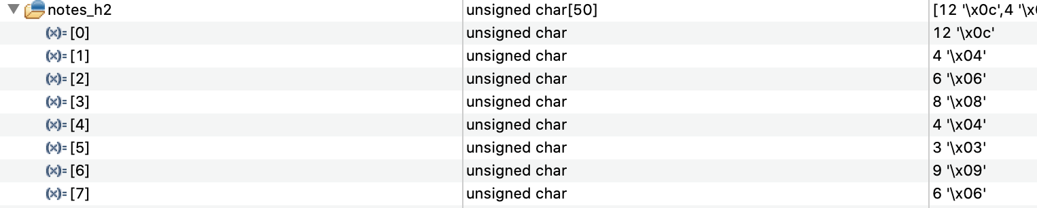
I2C MCU and DSP Integration

Slide 8
Microcontroller Unit
Main Unit Schematic/PCB
Accomplishments Since Last Presentation <~ hrs> | Ongoing progress/problems and plans
Integrated With all Other Systems
Accomplishments Since Last Presentation <30 Hrs> | Ongoing progress/problems and plans until next presentation
PCB and Parts Ordered | Solder and Test
Notes:
MCU will be relaying data to and fro the dsp/user interface via bluetooth. Telling the DSP what type of harmony the user wants, and then sending the digital to back to the app...

Slide 9
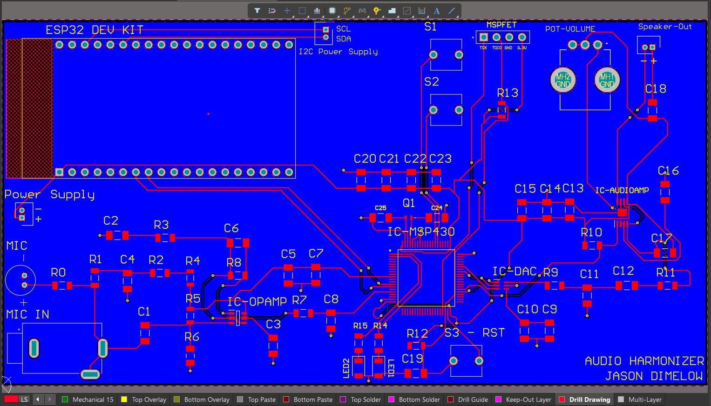
Schematics

Slide 10
Power Supply and Integration with MCU I2C Communication
Accomplishments Since Our Last Presentation <20 hrs> | Ongoing progress/problems and plans until next presentation
Tested PCB functionality Tested charger IC Fixed output voltage issue I2C communication between fuel gauge and MCU complete (reads state of charge, battery voltage, and capacitance) | Validate state of charge (%) reading of fuel gauge

Slide 11
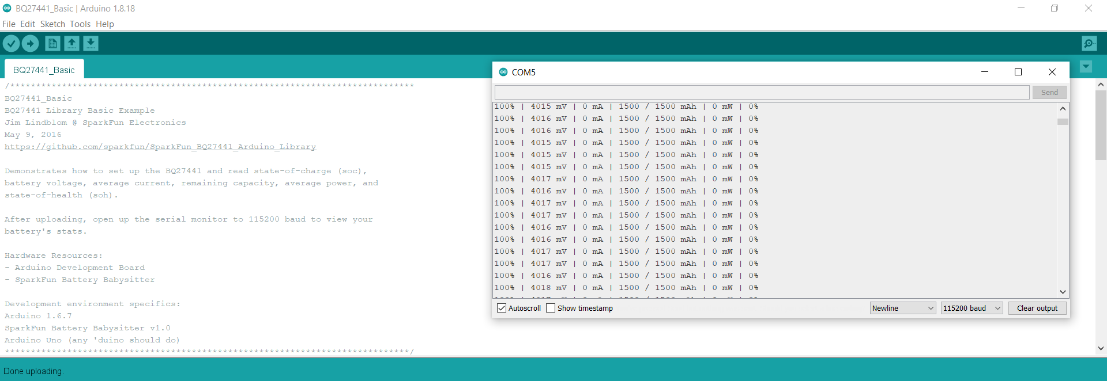
Fuel Gauge Integration

Slide 12
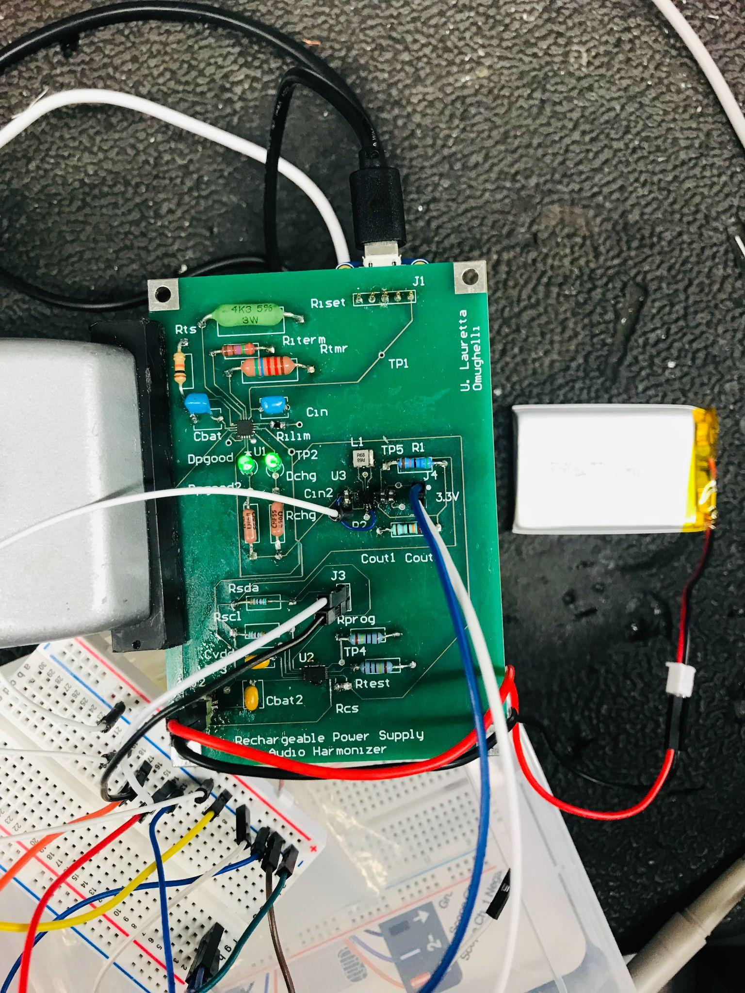
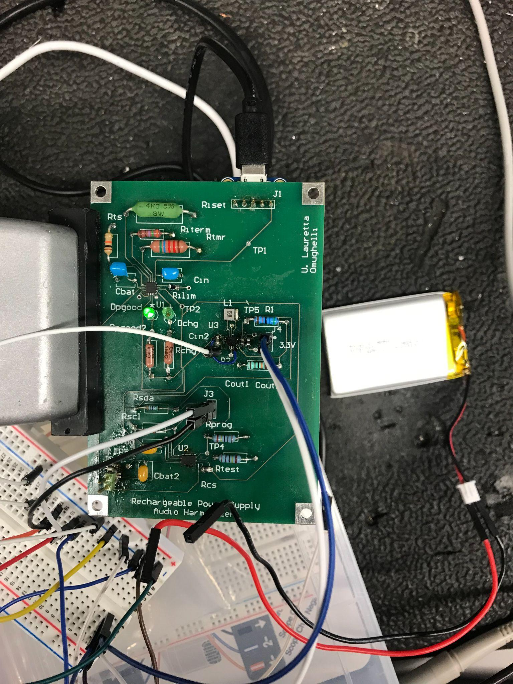
Power Supply Validation
Dchg LED is high Impedance when battery is connected
Dchg LED is low impedance when battery is disconnected
Shows that battery is disconnected/not charging
Shows that battery is charging
-LED on the left is always on to indicate that a valid input source is received

Slide 13
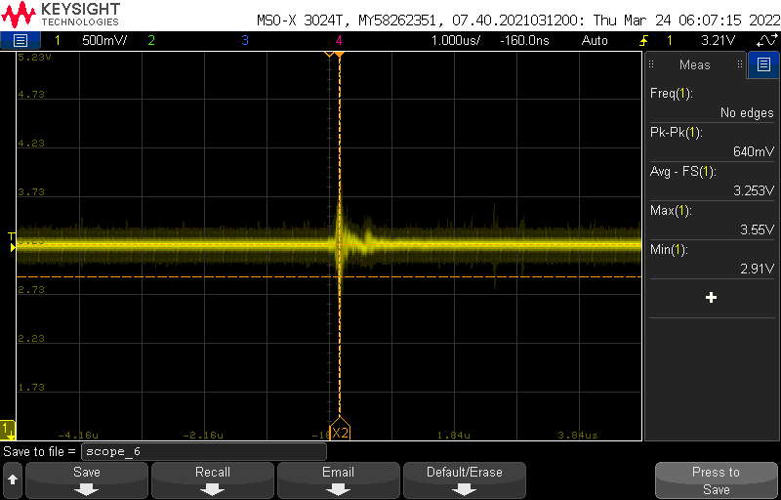
Power Supply Waveform
-Output voltage varies between 3.25-3.36V

Slide 14
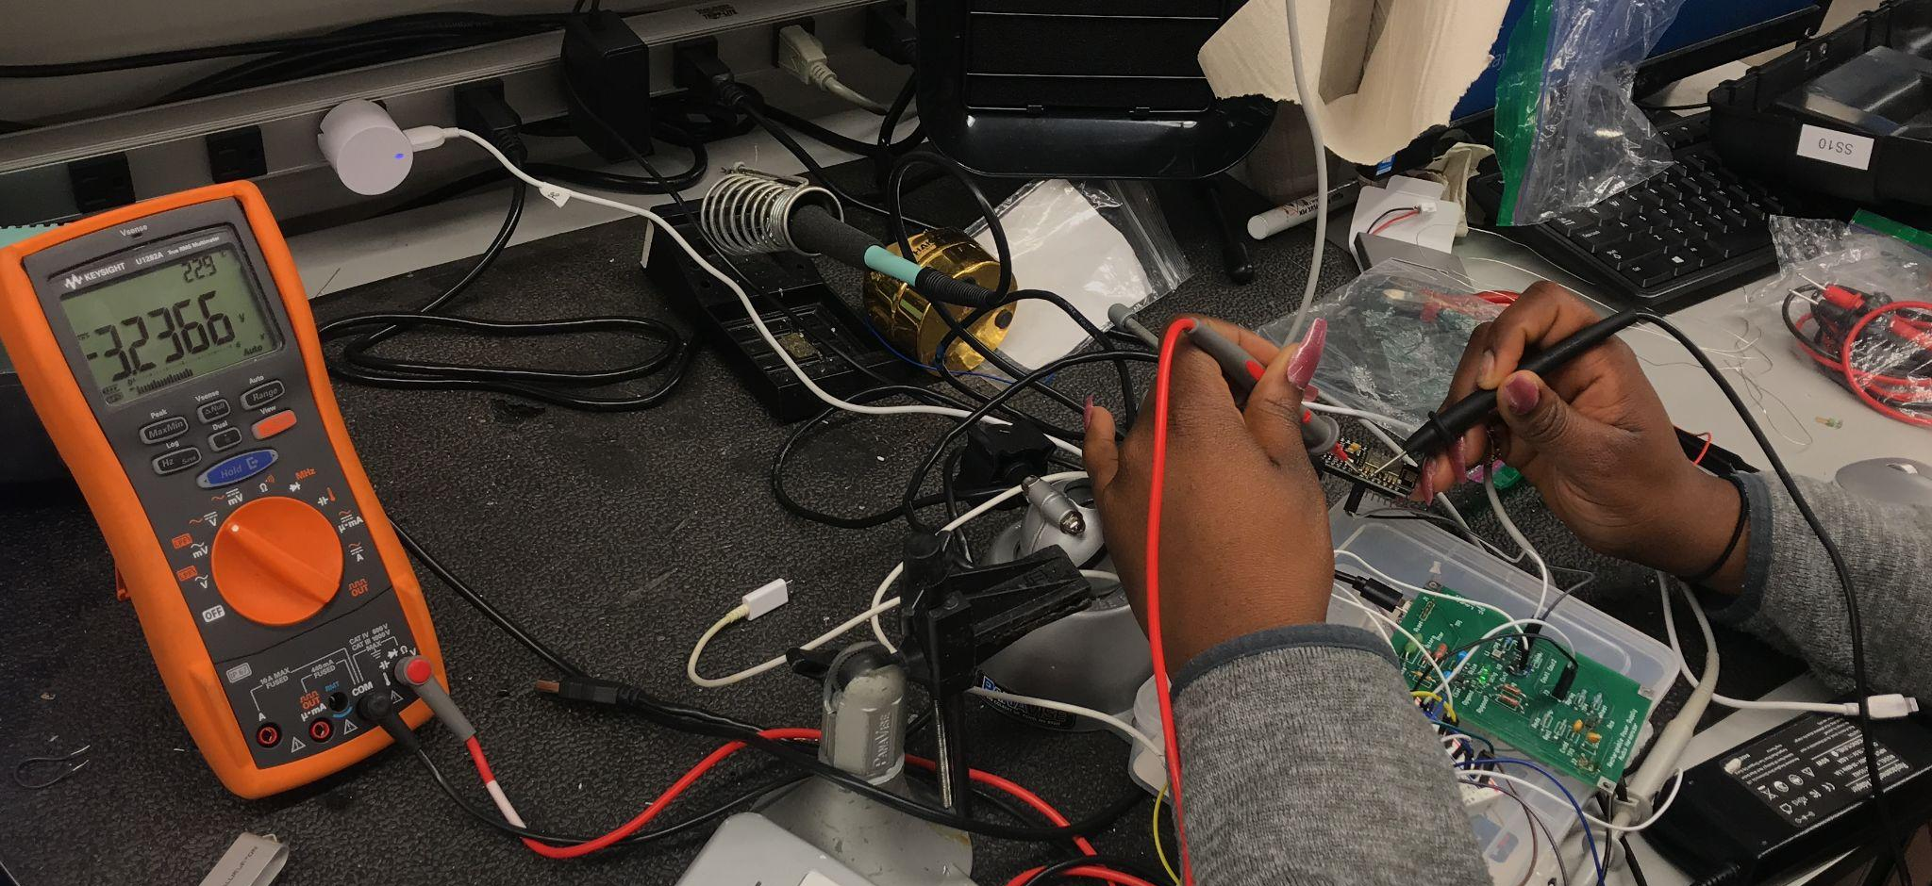
Power Supply Integration

Slide 15
Android App
Accomplishments Since Last Presentation <20 hrs> | Ongoing progress/problems and plans until next presentation
Error Handling Worked on Styling | Continue validating and integrating with full system

Slide 16
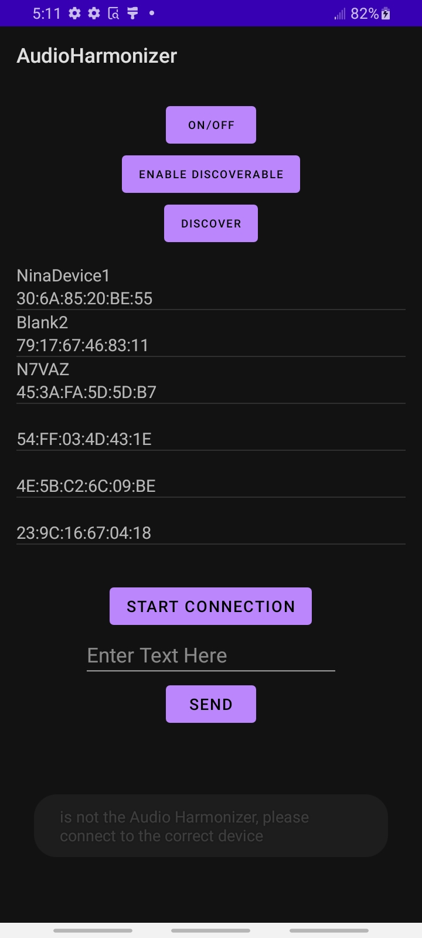
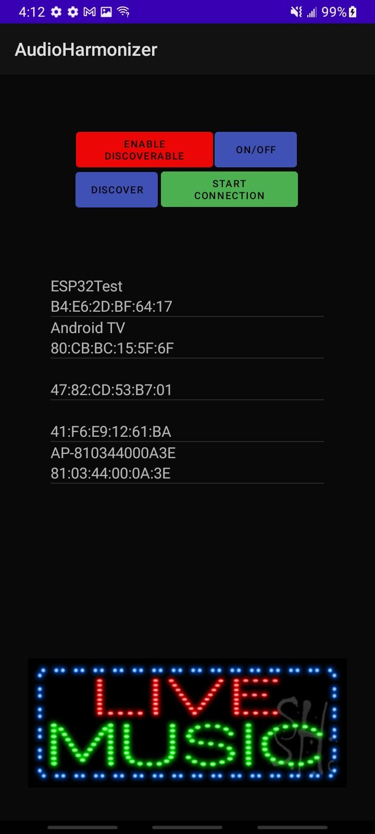
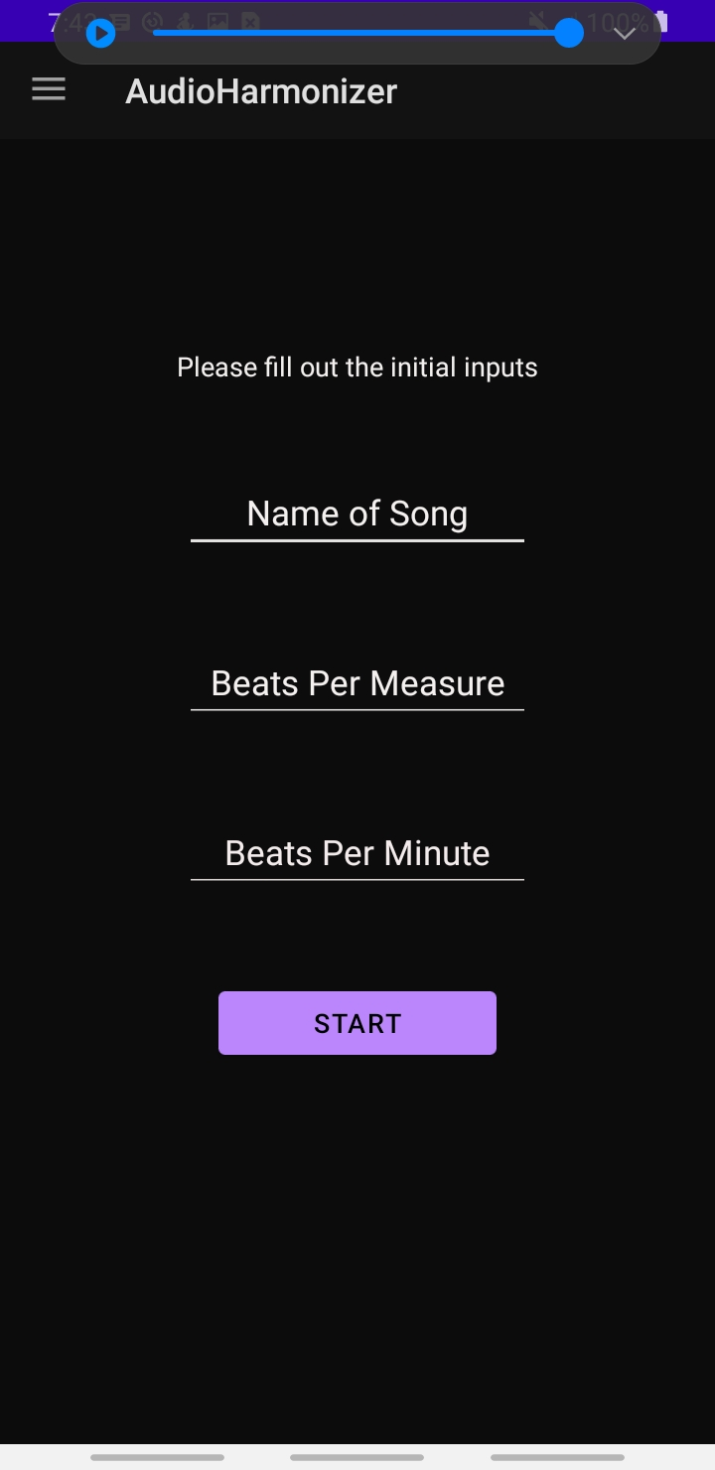
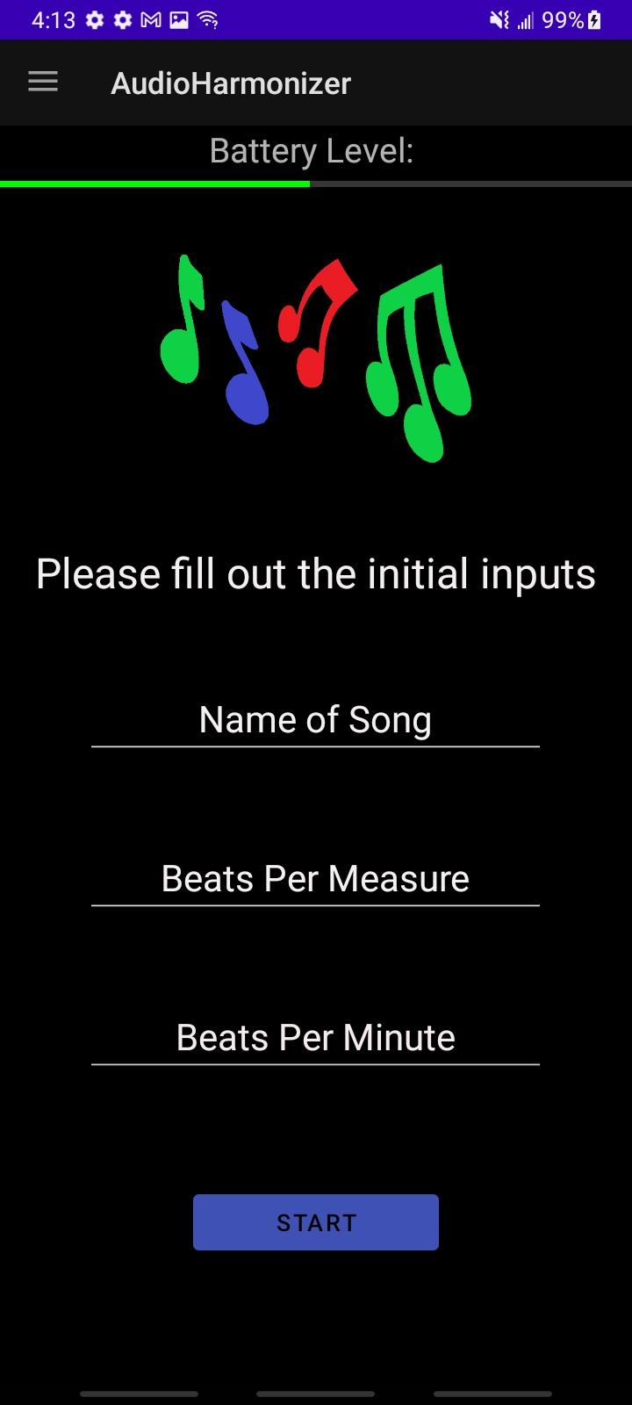
Before & After
Bluetooth Page
Initial Input Page

Slide 17
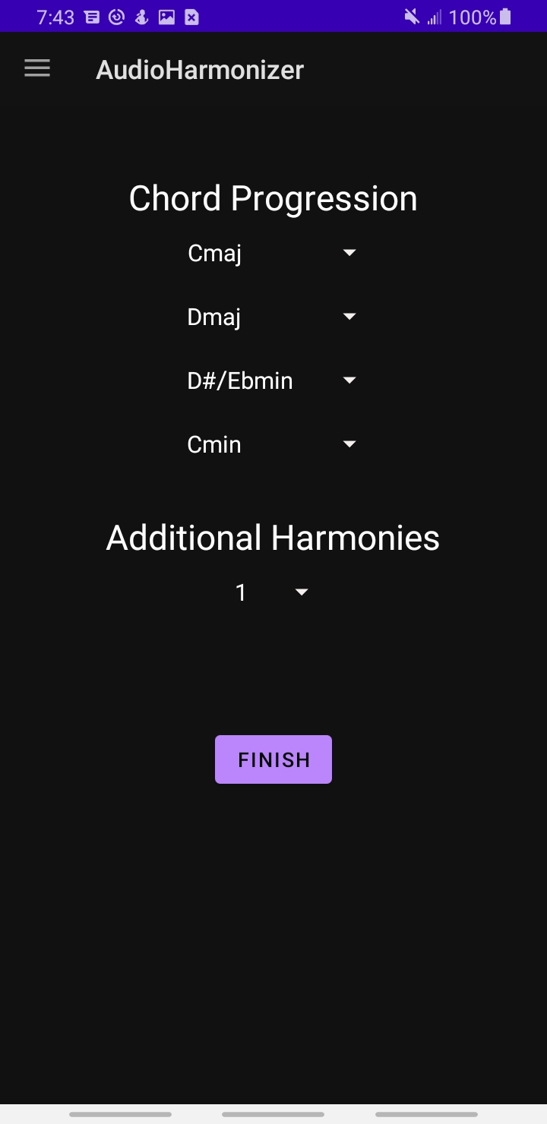
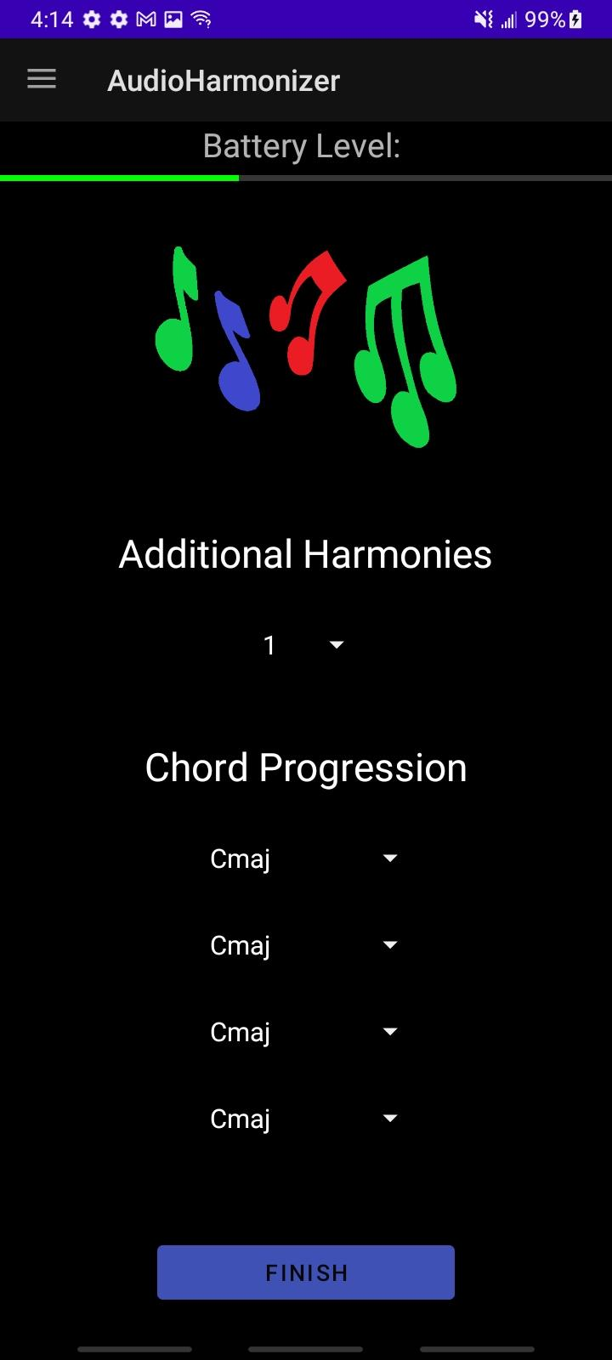
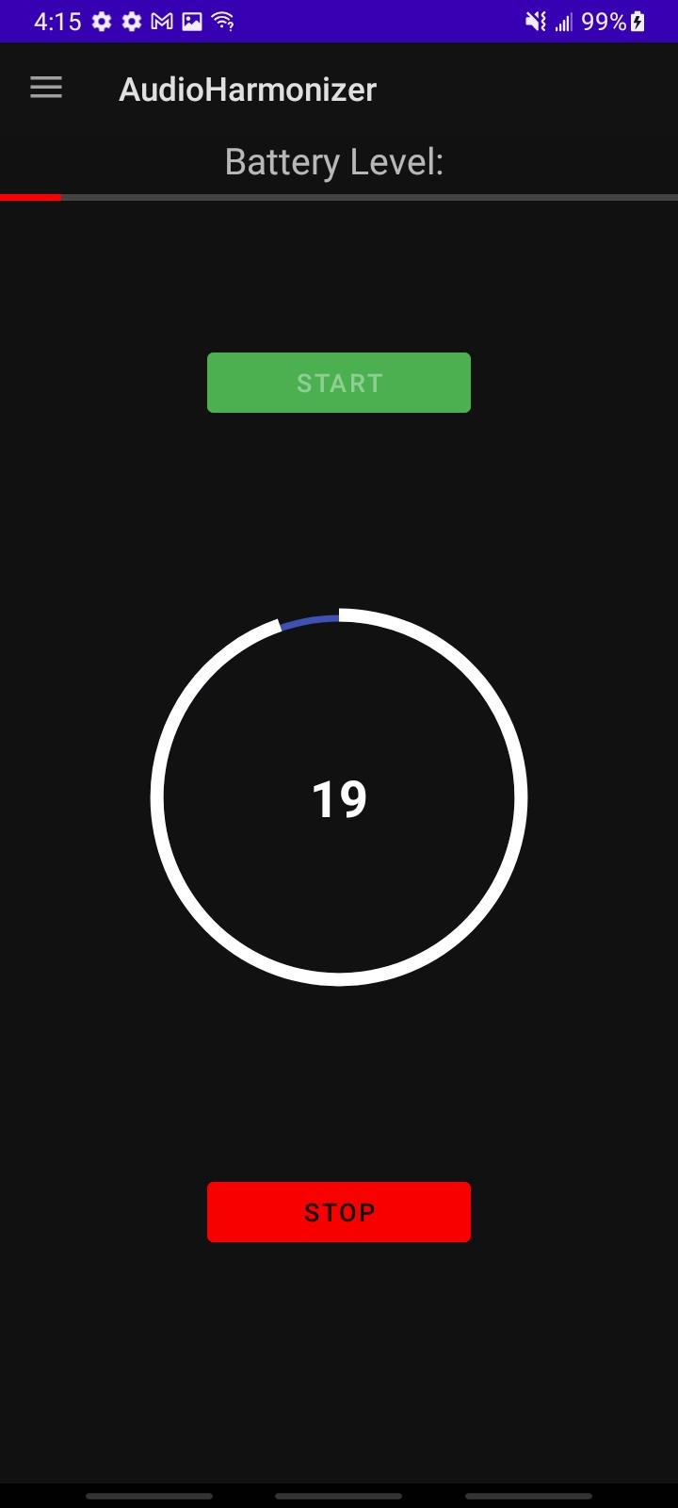
Before & After
Automatic Page
Start Singing Page

Slide 18
Progress

Slide 19
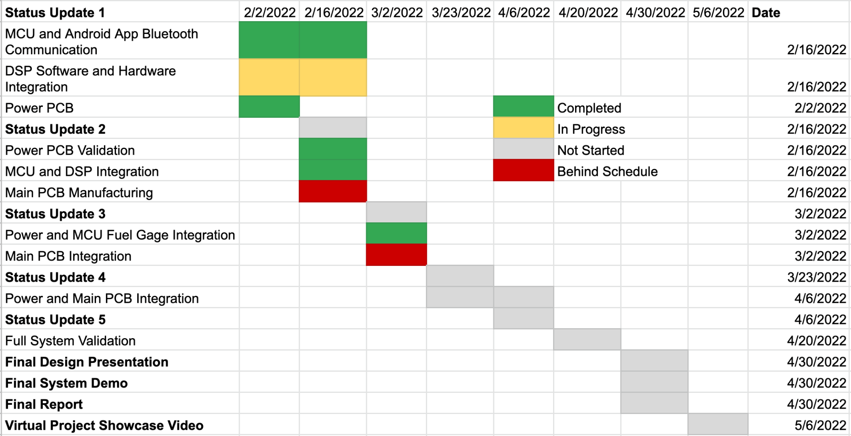
Execution Plan

Slide 20
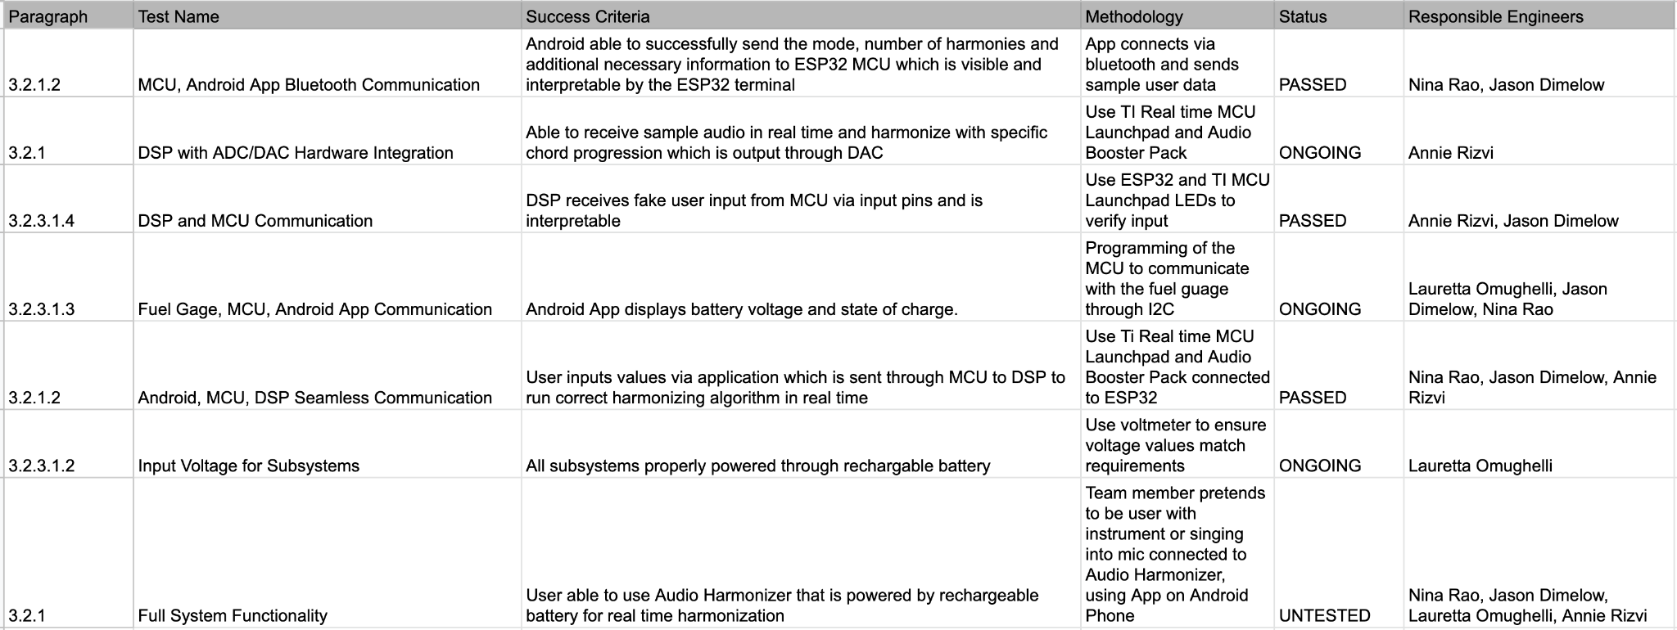
Validation Plan

Slide 21
Questions?

